Slide 1
Exploratory Data Analysis
G2M insight for Cab Investment firm
17/07/2022

Slide 2
Executive Summary
In the following presentation we will to analyze two companies in the Cab industry, in order to get a better understanding of the market and make the right decision as to which company XYZ should invest in.

Slide 3
Problem Statement
In our analysis we relied on 4 data files:
Cab_Data.csv: Detailed the transactions (Cost/Revenue/Km traveled…)
City.csv: Gave the number of users by city
Customer_ID.csv: Information about each user (Gender/Age/Income)
Transaction_ID.csv: Connected between the transaction and the user.

Slide 4
As we are dealing with 4 separate files, it is hard to get as much information as if they were all combined in one file. We had to first get a table that groups the data.

Slide 5
Approach
Using Pandas library on python, we are able to connect between customer ID (in file Customer_ID.csv) and transaction ID (in file Transaction_ID.csv) and file Cab_Data.csv:

Slide 6
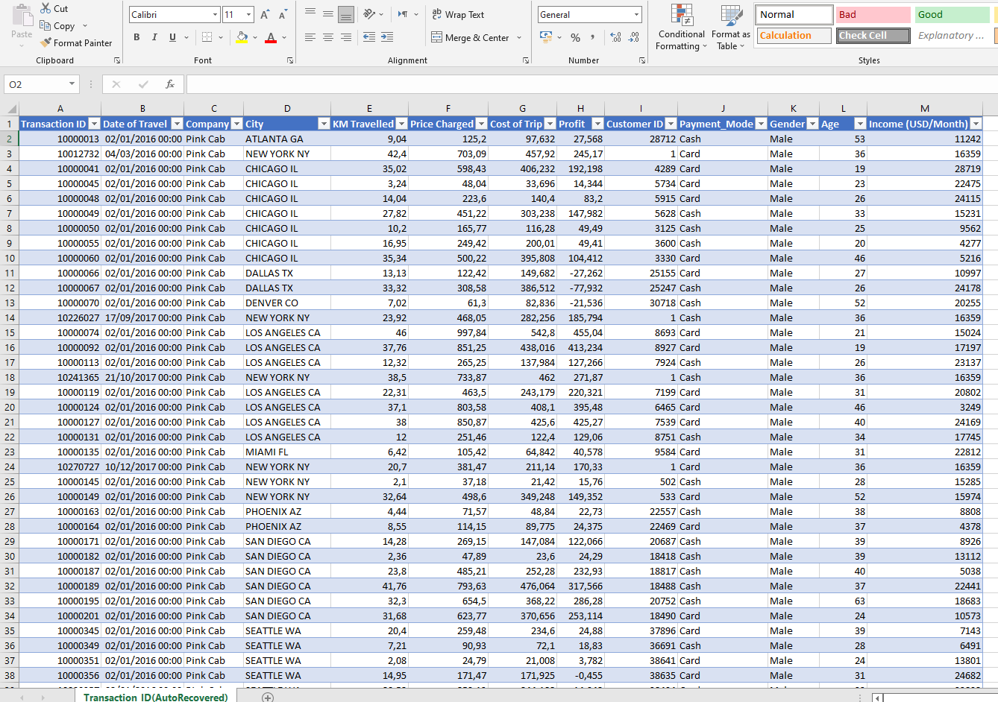

Slide 7
EDA
DATA EXPLORATION:
We have a total of 355,032 data points We also have 4 .csv files:
-Cab_Data.csv: 7 features -City.csv: 3 features -Customer_ID.csv: 4 features -Transaction_ID.csv: 3 features

Slide 8
WHAT IS THE MEAN AGE OF CAB USERS IN EACH COMPANY?
Mean age of Yellow cab users: 35.34
Mean age of Pink cab users: 35.32

Slide 9
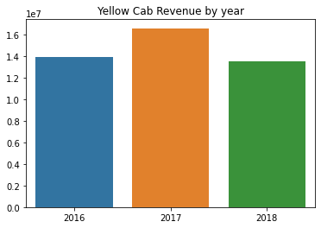
Profit Analysis
What is the revenue by year of each company by Year?
YELLOW CAB

Slide 10
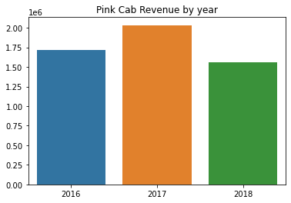
PINK CAB

Slide 11
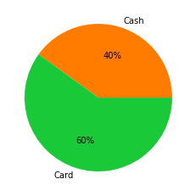
MOST COMMON METHOD OF PAYMENT BY COMPANY
Percentage of Cash use (Yellow Cab): 40.01
Percentage of Card use (Yellow Cab): 59.99

Slide 12

Percentage of Cash use (Pink Cab): 40.13
Percentage of Card use (Pink Cab): 59.87

Slide 13
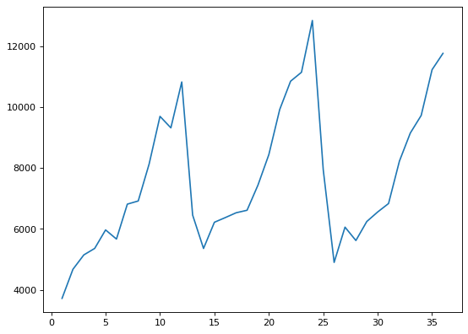
SEASONALITY OF DEMAND
Is there any seasonality in number of customers using the cab service?
YELLOW CAB:

Slide 14
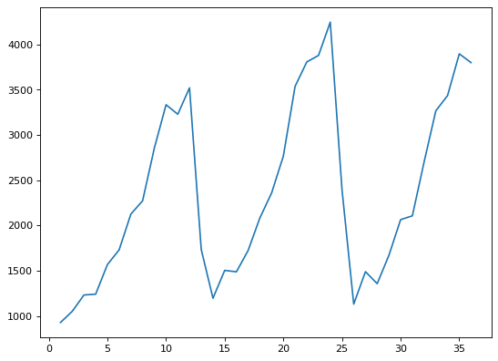
PINK CAB:

Slide 15
We notice seasonality of demand, with large increase of demand towards the end of each year. (winter)

Slide 16
GENDER DISTRIBUTION BY COMPANY
Percentage of Males (Yellow Cab): 57.77
Percentage of Females (Yellow Cab): 42.23

Slide 17
Percentage of Males (Yellow Cab): 55.76
Percentage of Females (Yellow Cab): 44.24

Slide 18
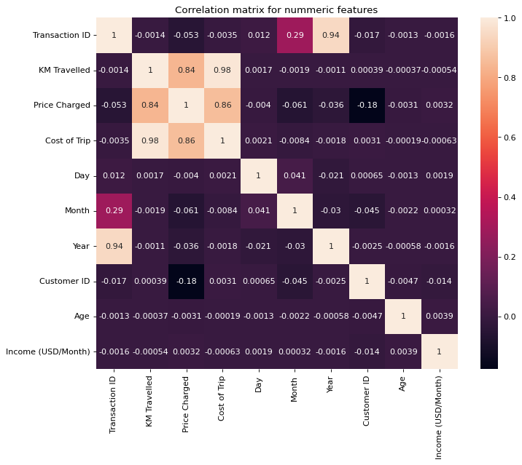
WHAT ARE THE CORRELATED FEATURES?

Slide 19
Highest Correlation is between "KM Travelled" and "Cost of Trip"

Slide 20
IS THERE A CORRELATION BETWEEN GENDER AND DISTANCE TRAVELLED?
On average, a male will travel: 22.55km
On average, a female will travel: 22.59km
Conclusion: There is no correlation between gender and distance travelled.

Slide 21
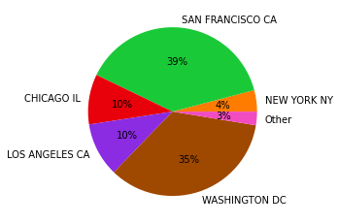
PERCENTAGE OF USERS BY CITY

Slide 22
WHICH COMPANY MADE MORE PROFIT PER KM TRAVELLED IN 2018?
Yellow Cab makes 6.36 dollars per km travelled!
Pink Cab makes 2.36 dollars per km travelled!

Slide 23
Recommendation
We have evaluated both companies on the following points:
- Profit of Previous 3 years: Yellow cab has made around 9 times more profit than Pink Cab did during the period of 2016-2018
- Profit by Year: We observed a decline in profit in both companies, nevertheless, Yellow Cab still has a much higher profit percentage each year averaging around 34.6% profit, while Pink Cab only averages 18.97%.

Slide 24
- Average Profit Per KM: Yellow Cab profits almost 3 times more than Pink Cab does in each km traveled
- Profit Gender Wise: Males contribute the most to both companies profits and at around the same percentage.
- Profit based on income: By analyzing the data, we observed that customers, in both companies, belong to similar social class. We also notice that both companies make the most profit off of customers with higher income (>15 000).
- Seasonality in the demand: We noticed that the demand spikes during winter in both companies.
- Cab Market is most popular in San Francisco
Based on those points, we recommend the investment in Yellow Cab.

